Slide 1

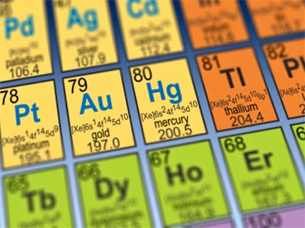
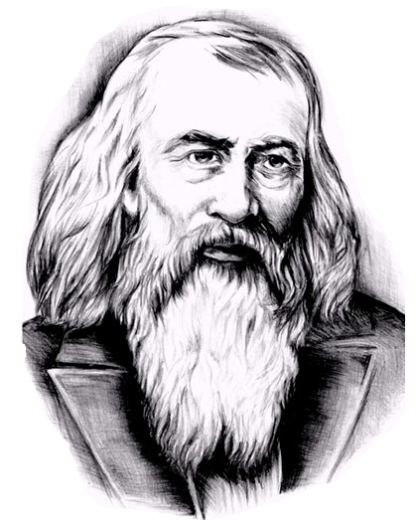
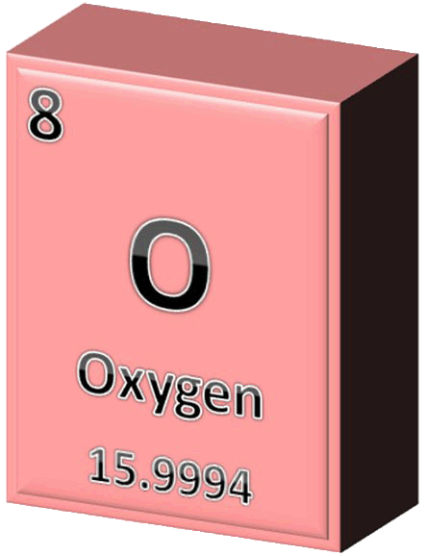
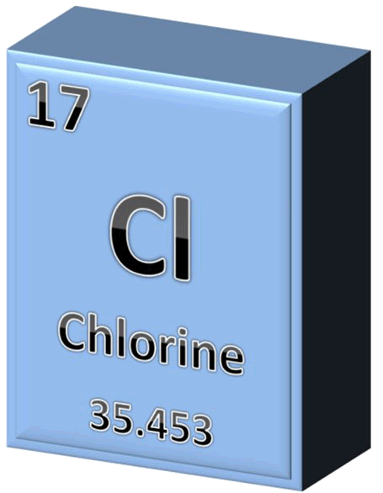
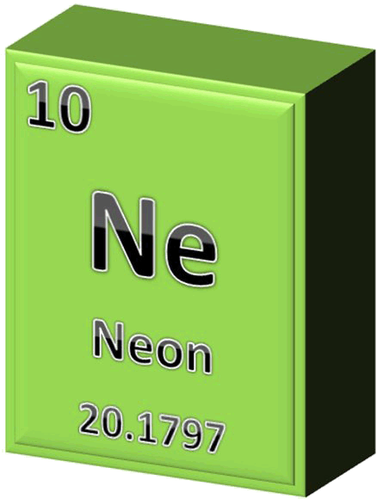
THE
PERIODIC
TABLE

Slide 2

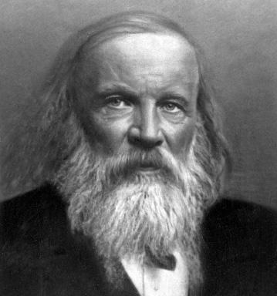
INTRODUCING THE PERIODIC TABLE
It is a chart that organizes ________
Periodic Table:
elements
according to their _______________________
increasing atomic numbers
and their ___________________
_________.
chemical and physical
properties
When was the Periodic Table developed and who created it?
1869
Dmitri Mendeleev
It was developed in _____
by a man named ________________ who was a Russian chemist and inventor.

Slide 3
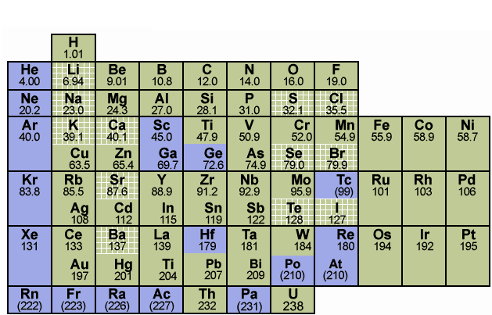
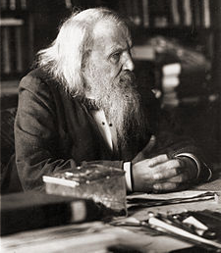
INTRODUCING THE PERIODIC TABLE
In his time, there were only ___________ discovered,
but his periodic table _________ and left room for the ________________ ___________.
60 elements
predicted
future discoveries
of elements
Maybe there are more elements?

Slide 4
INTRODUCING THE PERIODIC TABLE
Each element on the periodic table is represented within an ___________ which contains the following basic information.
element box
atomic number
(A whole number with no decimals.)
2⁺
oxidation number
(It has a + or – sign.)
element symbol
(Only the first letter is capitalized.)
element name
(It is larger than atomic number and always has decimals.)
atomic mass
a) Draw the box
for the element
that has an
atomic mass of
107.87.
b) Draw the box
for the element that has the element symbol Pt.
1⁺
4⁺
2⁺

Slide 5
ORGANIZATION OF THE PERIODIC TABLE
The periodic table is arranged in columns and rows.
Each column on the periodic table is called a ______.
group
There are ___ groups on the periodic table.
18
How many groups are there on the periodic table?

Slide 6
ORGANIZATION OF THE PERIODIC TABLE
The periodic table is arranged in columns and rows.
Each column on the periodic table is called a ______.
group
There are ___ groups on the periodic table.
18
period
Each row on the periodic table is called a ________.
7
There are __ periods on the periodic table.
How many periods are there on the periodic table?

Slide 7
ORGANIZATION OF THE PERIODIC TABLE
There is a zigzag that separates the periodic table into two sides.
staircase
This zigzag is also called the ________.
metals
To the left of the staircase you will find all the ______.
non-metals
To the right of the staircase you will find all the __________ ,
hydrogen
except for the element _________ ,
which is a non-metal
found on the left side.
Can you find the zigzag on the periodic table?
non-metals
metals

Slide 8
ORGANIZATION OF THE PERIODIC TABLE
Directly to either side of the staircase you will find elements called _________ .
metalloids
8
There are __ of these types of elements.
metalloids

Slide 9
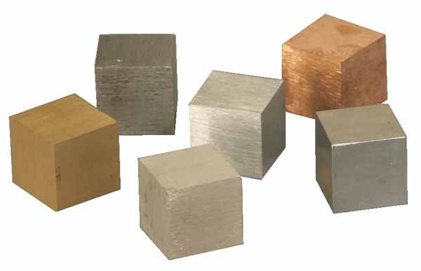
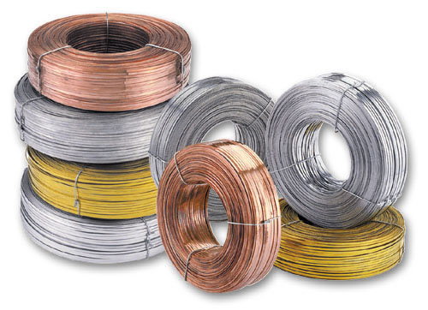
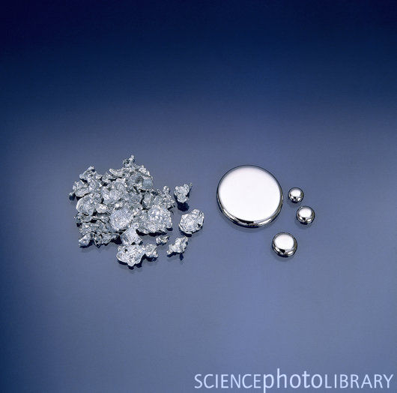
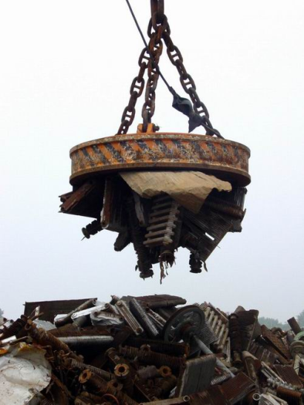
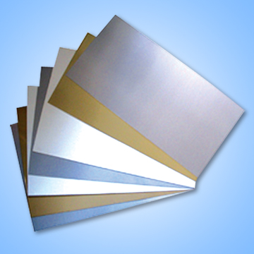

METALS, NON-METALS & METALLOIDS
Metals:
solids
All metals are _____ at room temperature
except for
________ which is a _____ .
mercury
liquid
Many metals are _______ and ______ in color, ______ , _________ , __________ and some are ________.
lustrous
silvery
ductile
malleable
conductive
magnetic
Hg
Cu

Slide 10

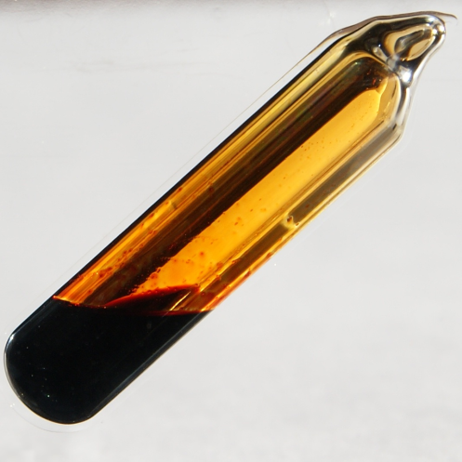
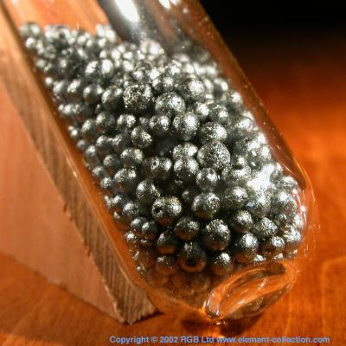
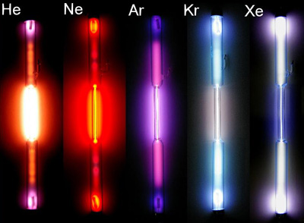
METALS, NON-METALS & METALLOIDS
Non-Metals:
gases
bromine
Most non-metals are _____ ,
except for ________
which is a _____ ,
liquid
and five non-metals which
are _____ .
solids
These ones are: ______ , __________ , _____ , ________ , and ______.
carbon
phosphorus
sulfur
selenium
iodine
I
Br
colorless
various colors
Non-metal elements are either ________ or have ____________.
not malleable
not ductile
brittle
They are ____________ , __________ , ______ when solid, ______________ and ____________.
poor conductors
nonmagnetic

Slide 11
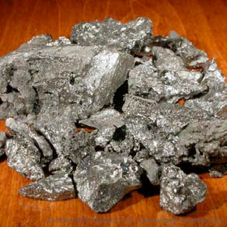
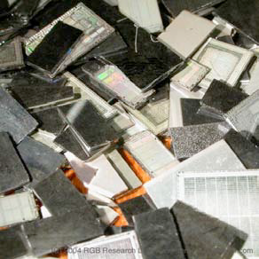
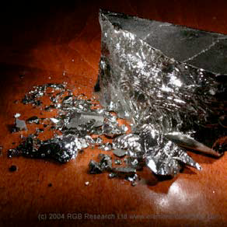
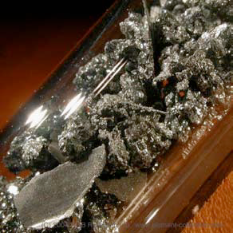
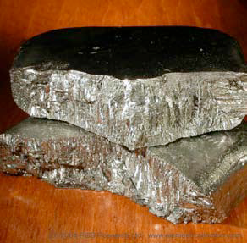
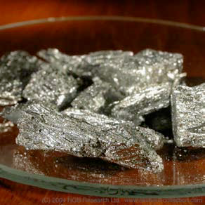
METALS, NON-METALS & METALLOIDS
Metalloids:
all solids
Metalloids are ________ at room temperature.
both
They have some properties of ____ metals and non-metals.
metallic
They are mostly _______ in appearance but they are ______.
brittle
fair
They are ___ electrical conductors.
B
Si
Ge
As
Sb
Te

Slide 12
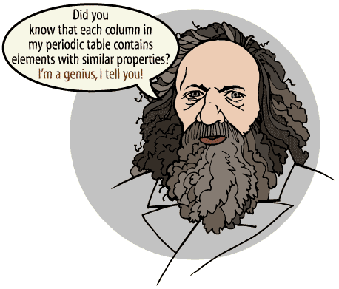
CHEMICAL FAMILIES ON THE PERIODIC TABLE
Is a group (column) that contains elements with similar _________ .
Chemical Family:
properties

Slide 13
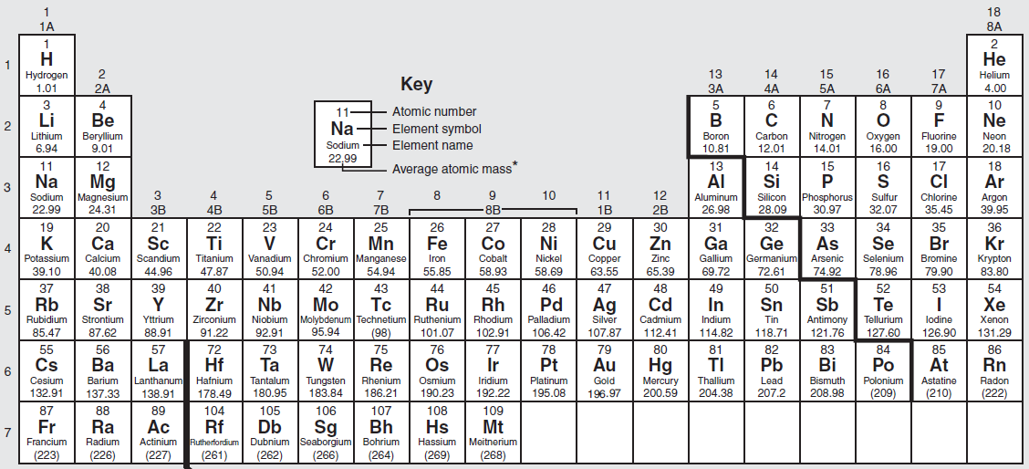
CHEMICAL FAMILIES ON THE PERIODIC TABLE
Is a group (column) that contains elements with similar _________ .
Chemical Family:
properties
Group 1:
Alkali Metals

Slide 14
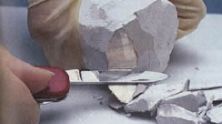
CHEMICAL FAMILIES ON THE PERIODIC TABLE
Group 1:
Alkali Metals
This group of elements are all
____ and _____-colored _____ .
soft
silver
solids
most
They are the _____ reactive of all the metals because…
one
they only have ____ valence electron.
Li
Na
K

Slide 15
CHEMICAL FAMILIES ON THE PERIODIC TABLE
Group 1:
Alkali Metals
This group of elements are all
____ and _____-colored _____ .
soft
silver
solids
most
They are the _____ reactive of all the metals because…
one
they only have ____ valence electron.
bond
They each very readily _____ with other elements
transferring
by __________ their valence electron
Sodium Atom
Chlorine Atom
Na
Cl

Slide 16
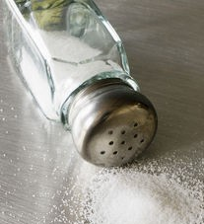
CHEMICAL FAMILIES ON THE PERIODIC TABLE
Group 1:
Alkali Metals
This group of elements are all
____ and _____-colored _____ .
soft
silver
solids
most
They are the _____ reactive of all the metals because…
one
they only have ____ valence electron.
bond
They each very readily _____ with other elements
transferring
to each become a stable ___,
by __________ their valence electron
ion
full
meaning they have a ___ outer orbital.
The bond between the ions creates a ____ substance
Sodium Atom
Chlorine Ion
Sodium Ion
Chlorine Atom
new
Na
Cl
called a
_________.
NaCl
compound
table salt

Slide 17


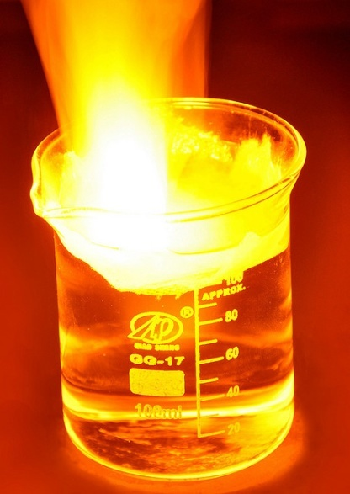
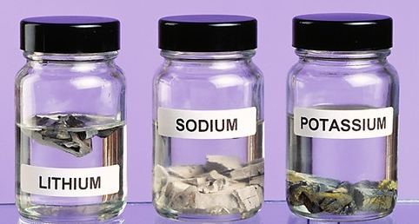
CHEMICAL FAMILIES ON THE PERIODIC TABLE
Group 1:
Alkali Metals
water
They are all reactive with _____.
water vapor
To prevent contact with ___________ in the air, they are stored in _________.
mineral oil
Fr
more
Elements get _____ reactive as you go _____ the group.
down
Francium
...and it’s…
→ ________ is the most reactive.
water
mineral oil

Slide 18
CHEMICAL FAMILIES ON THE PERIODIC TABLE
Is a group (column) that contains elements with similar _________ .
Chemical Family:
properties
Group 1:
Alkali Metals
Group 2:
Alkaline Earth Metals

Slide 19
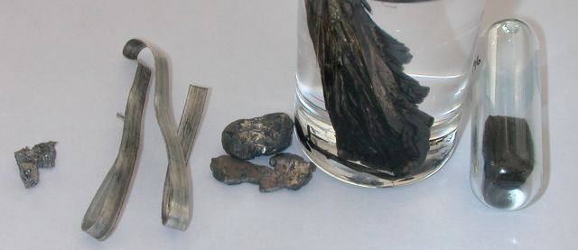
CHEMICAL FAMILIES ON THE PERIODIC TABLE
Group 2:
Alkaline Earth Metals
silver
solids
These elements are also all _____-colored _____ .
water
less
They are also reactive with _____ but ____ so than group 1 elements
two
→ They each have ___ valence electrons.
Be
Mg
Ca
Sr
Ba

Slide 20
CHEMICAL FAMILIES ON THE PERIODIC TABLE
Group 2:
Alkaline Earth Metals
silver
solids
These elements are also all _____-colored _____ .
water
less
They are also reactive with _____ but ____ so than group 1 elements
two
→ They each have ___ valence electrons.
Be
Mg
Ca

Slide 21
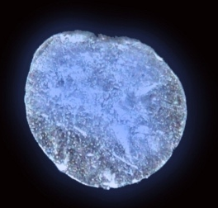
CHEMICAL FAMILIES ON THE PERIODIC TABLE
Group 2:
Alkaline Earth Metals
silver
solids
These elements are also all _____-colored _____ .
water
less
They are also reactive with _____ but ____ so than group 1 elements.
two
→ They each have ___ valence electrons.
Similar to group 1 elements, they readily bond with other elements.
However, in this case they transfer their ____ valence electrons to become stable ions with full outer orbitals.
two
more
down
Elements get _____ reactive as you go _____ the group.
Radium
→ _______ is the most reactive.
...and it’s also…
Ra

Slide 22
CHEMICAL FAMILIES ON THE PERIODIC TABLE
Is a group (column) that contains elements with similar _________ .
Chemical Family:
properties
Group 1:
Alkali Metals
Groups 17:
Halogens
Group 2:
Alkaline Earth Metals

Slide 23
CHEMICAL FAMILIES ON THE PERIODIC TABLE
Groups 17:
Halogens
This group of elements are all __________
non-metals
and are found in all _____ states.
three
gas
most
They are the _____ reactive of the non-metals
seven
Because they have _____ valence electrons.
→ 1 electron short of a full outer orbital.
They readily combine with other elements to ________ valence electron from them to become stable ions (with full outer shells).
liquid
take one
solid
F
Cl

Slide 24
CHEMICAL FAMILIES ON THE PERIODIC TABLE
Groups 17:
Halogens
This group of elements are all __________
non-metals
and are found in all _____ states.
three
gas
most
They are the _____ reactive of the non-metals
seven
Because they have _____ valence electrons.
→ 1 electron short of a full outer orbital.
They readily combine with other elements to ________ valence electron from them to become stable ions (with full outer shells).
liquid
take one
Sodium Ion
Chlorine Ion
solid
Recall:
Na
Cl

Slide 25

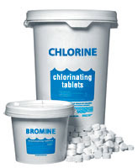
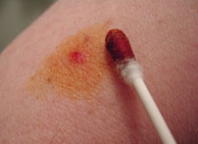
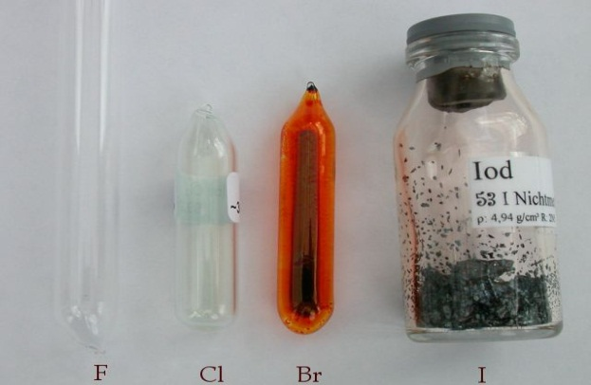


CHEMICAL FAMILIES ON THE PERIODIC TABLE
Groups 17:
Halogens
Halogens become more reactive as you move ___ the group.
up
gas
Fluorine
→ _______ is the most reactive.
liquid
I
solid
F
Cl
Br
I

Slide 26
CHEMICAL FAMILIES ON THE PERIODIC TABLE
Is a group (column) that contains elements with similar _________ .
Chemical Family:
properties
Group 1:
Alkali Metals
Groups 17:
Halogens
Group 2:
Alkaline Earth Metals
Groups 18:
Noble
Gases

Slide 27




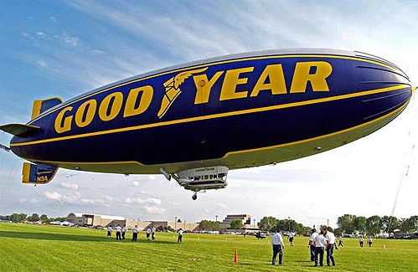
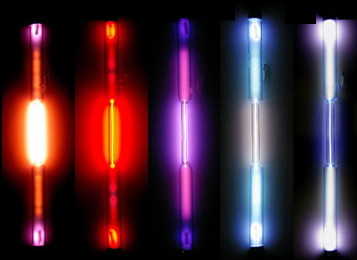
CHEMICAL FAMILIES ON THE PERIODIC TABLE
Groups 18:
Noble Gases
These non-metal elements are ___________ gases.
non-reactive
He
Ne
Ar
Kr
Xe

Slide 28
CHEMICAL FAMILIES ON THE PERIODIC TABLE
Groups 18:
Noble Gases
do not
They ______ bond with other elements
full
because they have ___ outer orbitals.
He
Ne
Ar
Since they don’t react with other elements, they ______ form __________.
do not
compounds
inert gases
→ Noble gases are also described as __________.

Slide 29
CHEMICAL FAMILIES ON THE PERIODIC TABLE
Is a group (column) that contains elements with similar _________ .
Chemical Family:
properties
Group 1:
Alkali Metals
Groups 17:
Halogens
Group 2:
Alkaline Earth Metals
Groups 3-12:
Transition Metals
Groups 18:
Noble
Gases

Slide 30
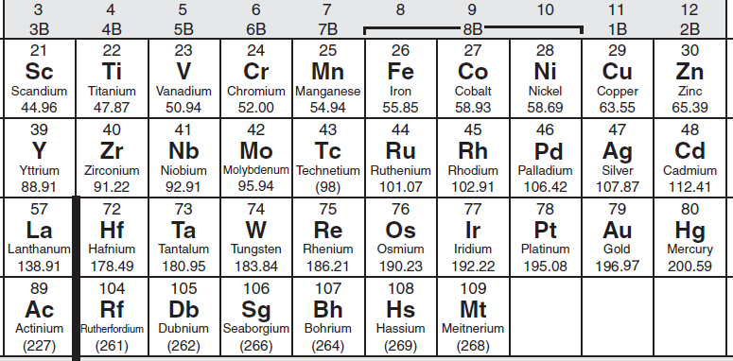
CHEMICAL FAMILIES ON THE PERIODIC TABLE
Groups 3-12:
Transition Metals
These groups contain metals that have the usual properties of metals.
(Lustrous, malleable, ductile, electrically conductive, etc.)
mercury
These metals are all found in the solid state except for _______
which is a _____ at room temperature and pressure.
liquid

Slide 31
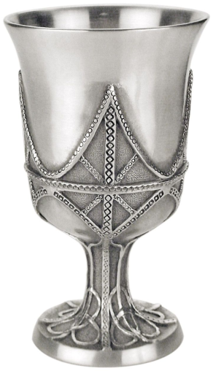
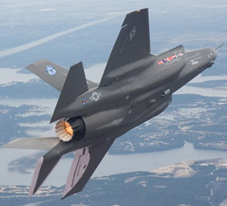
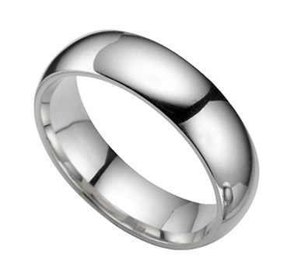
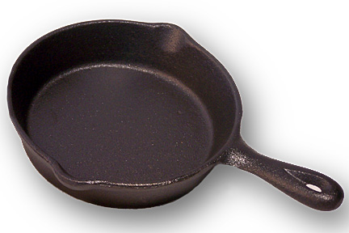
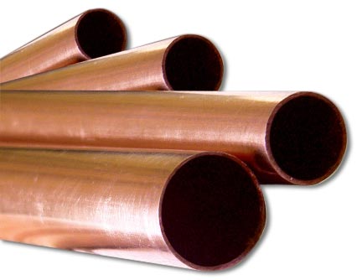

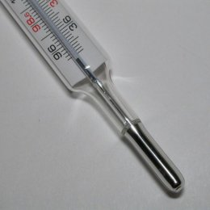
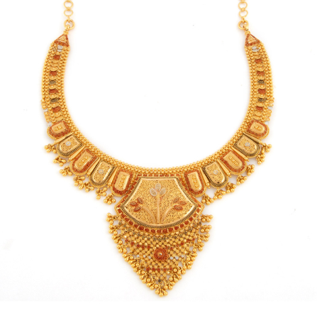
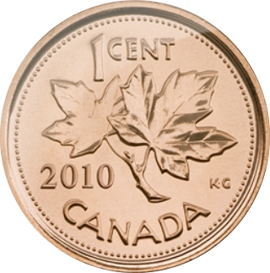
CHEMICAL FAMILIES ON THE PERIODIC TABLE
Groups 3-12:
Transition Metals
The transition metals contain some of the most commonly known metals.
platinum
ring
titanium
aircraft
silver
goblet
iron skillet
copper
pipes
copper
penny
tungsten
light bulb
mercury
thermometer
gold necklace

Slide 32
CHEMICAL FAMILIES ON THE PERIODIC TABLE
Chemical Family: Is a group (column) that contains elements with similar properties.
Group 1:
Alkali Metals
Groups 17:
Halogens
Group 2:
Alkaline Earth Metals
Groups 3-12:
Transition Metals
Groups 18:
Noble
Gases

Slide 33
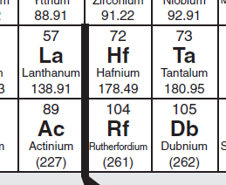
CHEMICAL FAMILIES ON THE PERIODIC TABLE

Slide 34
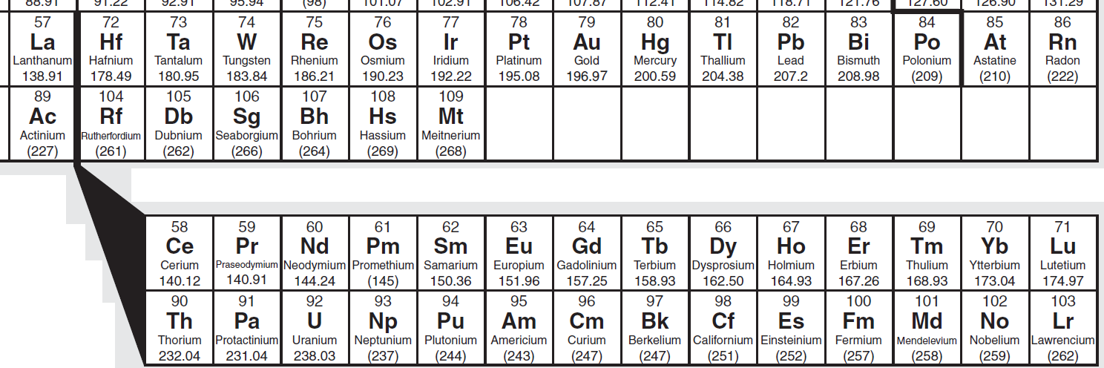
CHEMICAL FAMILIES ON THE PERIODIC TABLE
Lanthanides: Elements 57-71
metals
They are all ______ that have been
misleadingly labeled
“ _______________” in the past.
rare earth metals
Actinides: Elements 89-103
metals
radioactive
They are ______ that are __________.
combust
They will spontaneously ________ in the air.

Slide 35
The End!

Slide 36

Created by Anh-Thi Tang – Tangstar Science
Copyright © April 2013 Anh-Thi Tang (a.k.a. Tangstar Science)
All rights reserved by author.
This document is for personal classroom use only.
This entire document, or any parts within, may not be electronically distributed or posted to any website.

